Slide 2
CONTENT
Setting up a virtual environment
Using git
Time Series Data

Slide 3
VIRTUAL ENVIRONMENT
A virtual environment is a Python environment such that the Python interpreter, libraries and scripts installed into it are isolated from those installed in other virtual environments, and (by default) any libraries installed in a “system”.
Notes:
Consider this scenario: you are working on app A, using your system installed Python and you pip install package X version 1.0 to your global Python library. Then you switch to project B on your local machine, and you install the same package X but version 2.0, which has some breaking changes between version 1.0 and 2.0.
When you go back to run your app A, you get all sorts of errors, and your app does not run. This is a scenario you can run into when building software with Python. And to get around this, we can use virtual environments.

Slide 4
PIP ENVIRONMENT (PIPENV)
Pipenv is a packaging tool for Python that solves some common problems associated with the typical workflow using pip, virtualenv, and the good old requirements.txt.
In addition to addressing some common issues, it consolidates and simplifies the development process to a single command line tool.
Notes:
Consider this scenario: you are working on app A, using your system installed Python and you pip install package X version 1.0 to your global Python library. Then you switch to project B on your local machine, and you install the same package X but version 2.0, which has some breaking changes between version 1.0 and 2.0.
When you go back to run your app A, you get all sorts of errors, and your app does not run. This is a scenario you can run into when building software with Python. And to get around this, we can use virtual environments.

Slide 5

REQUIREMENTS.TXT
In Python requirement.txt file is a type of file that usually stores information about all the libraries, modules, and packages in itself that are used while developing a particular project. It also stores all files and packages on which that project is dependent or requires to run.
It serves as a list of items to be installed by pip, when using pip install. pip install requirements.txt
Notes:
Consider this scenario: you are working on app A, using your system installed Python and you pip install package X version 1.0 to your global Python library. Then you switch to project B on your local machine, and you install the same package X but version 2.0, which has some breaking changes between version 1.0 and 2.0.
When you go back to run your app A, you get all sorts of errors, and your app does not run. This is a scenario you can run into when building software with Python. And to get around this, we can use virtual environments.

Slide 6
PIP REQUIREMENTS (PIPREQS)
pipreqs is a simple library to automatically generate and create the requirements.txt file for your python projects and scripts.
pipreqs [options] [<path>]
Notes:
Consider this scenario: you are working on app A, using your system installed Python and you pip install package X version 1.0 to your global Python library. Then you switch to project B on your local machine, and you install the same package X but version 2.0, which has some breaking changes between version 1.0 and 2.0.
When you go back to run your app A, you get all sorts of errors, and your app does not run. This is a scenario you can run into when building software with Python. And to get around this, we can use virtual environments.

Slide 7
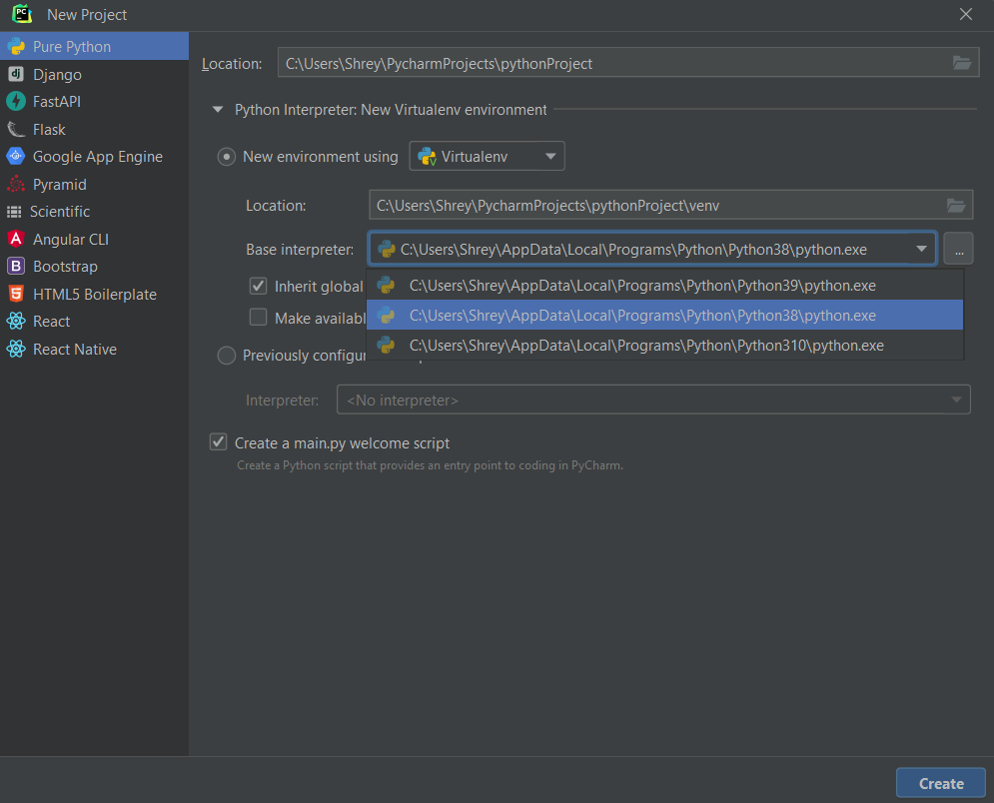
SETTING UP YOUR VIRTUAL ENVIRONMENT

Slide 8
GIT
Git is a free and open-source distributed version control system designed to handle everything from small to very large projects with speed and efficiency.

Slide 9
CREATE A LOCAL REPOSITORY
Open a Git Bash terminal and move to the directory where you want to keep the project on your local machine. For example:
cd ~/Desktop
mkdir myproject
cd myproject/
Create a Git repository in the selected folder by running the “git init” command. The syntax is:
git init [repository-name]

Slide 10
Log in and click on the “New repository” option under the + sign next to your profile picture, in the top right corner.
Enter a name for your repository, provide a brief description, and choose a privacy setting.
Click the Create repository button.
GitHub allows you to add an existing repo you have created locally. To push a local repository from your machine to GitHub, use the following syntax:
git remote add origin https://github.com/[your-username]/[repository-name.git]

Slide 11
ADD A FILE TO REPOSITORY
You can check which files git is tracking by running:
git status
Git notifies you if you have any untracked files. To start tracking a file, run the following command:
git add [filename]

Slide 12
CREATE A COMMIT
After adding the files to the staging environment, instruct Git to package the files into a commit using the git commit command. The syntax is:
git commit –m “Notes about the commit”
To undo a published commit, use the following syntax:
git revert [hash]
A hash is a code that identifies each commit. Obtain a commit hash by running:
git log

Slide 13
CREATE A BRANCH
Creating a new Git branch means creating a copy of the project from a specific point in time. Branches in Git allow users to make new features without applying the changes to the main branch while the feature is in development. To create a branch, run the following command:
git branch [new_branch_name]
To switch between branches, use the following syntax:
git checkout [branch_name]
To rename a local Git branch, use the following syntax:
git branch –m [new-name]
To delete a local Git branch, use the following syntax:
git branch –d [branch_name]

Slide 14
FETCH/PUSH/PULL
The git fetch command downloads the commits, files and refs from a remote repository into your local repo. When downloading content from a remote repo, git pull and git fetch commands are available to accomplish the task.
The git pull command is used to fetch and download content from a remote repository and immediately update the local repository to match that content.
git fetch [remote_name] [branch_name]
git pull [remote_name]
The git push command is used to upload local repository content to a remote repository.
git push [remote_name] [branch_name]

Slide 15
TIME – SERIES DATA ANALYSIS
Time series analysis is a specific way of analyzing a sequence of data points collected over an interval of time.
In time series analysis, analysts record data points at consistent intervals over a set period of time rather than just recording the data points intermittently or randomly.
Time series analysis typically requires a large number of data points to ensure consistency and reliability.
Additionally, time series data can be used for forecasting—predicting future data based on historical data.

Slide 16
TIME SERIES DATA
ANALYSIS IN PYTHON

Slide 17
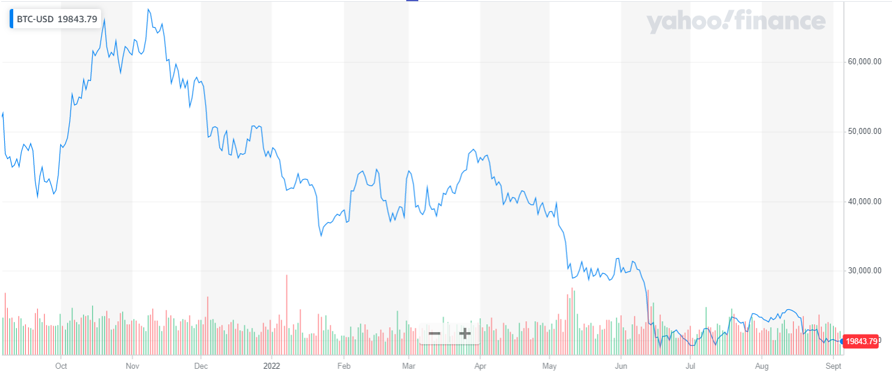
BITCOIN (BTC) 1-YEAR PRICE (USD)

Slide 18
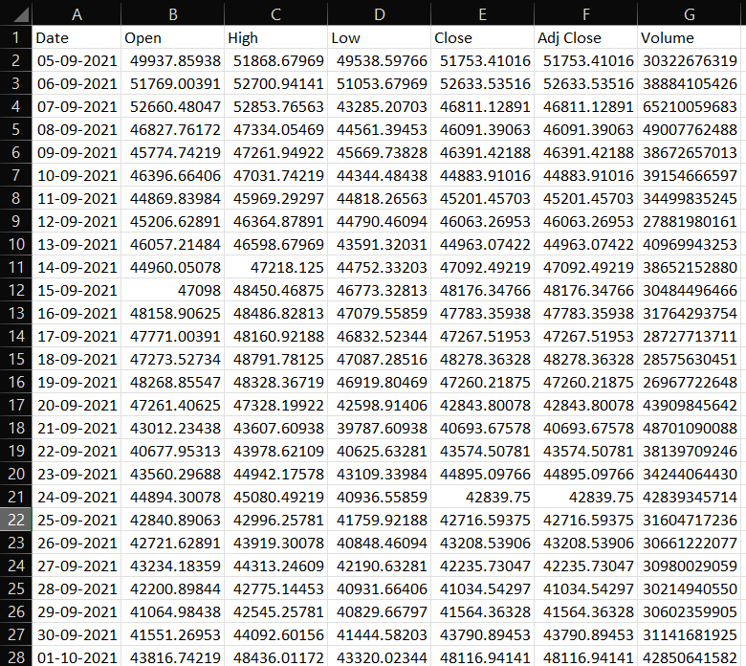
BITCOIN (BTC) 1-YEAR PRICE (USD)
Open – Price of stock when market opened
High – Highest price of stock during the day
Low – Lowest price of stock during the day
Close – Price of stock when market closed
Adj Close – lose price adjusted for splits and dividends and/or capital gain distributions.
Volume – Number of shares traded on the day

Slide 19
IMPORT BASIC LIBRARIES
import matplotlib as mpl
import matplotlib.pyplot as plt
import seaborn as sns
import numpy as np
import pandas as pd

Slide 20
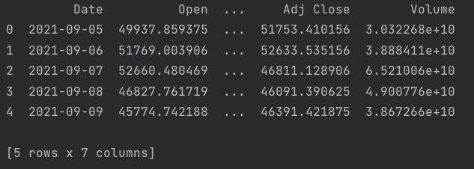
IMPORT PRICE DATA
df = pd.read_csv('BTC-USD.csv')
print(df.head())

Slide 21
VISUALIZING TIME SERIES DATA
df.plot ( x = “Date”,
y = “Close”,
kind = “line”,
figsize = (15,8),
title = “Bitcoin Price in USD”,
xlabel = “Date”,
ylabel = “Price” )
plt.show()

Slide 22
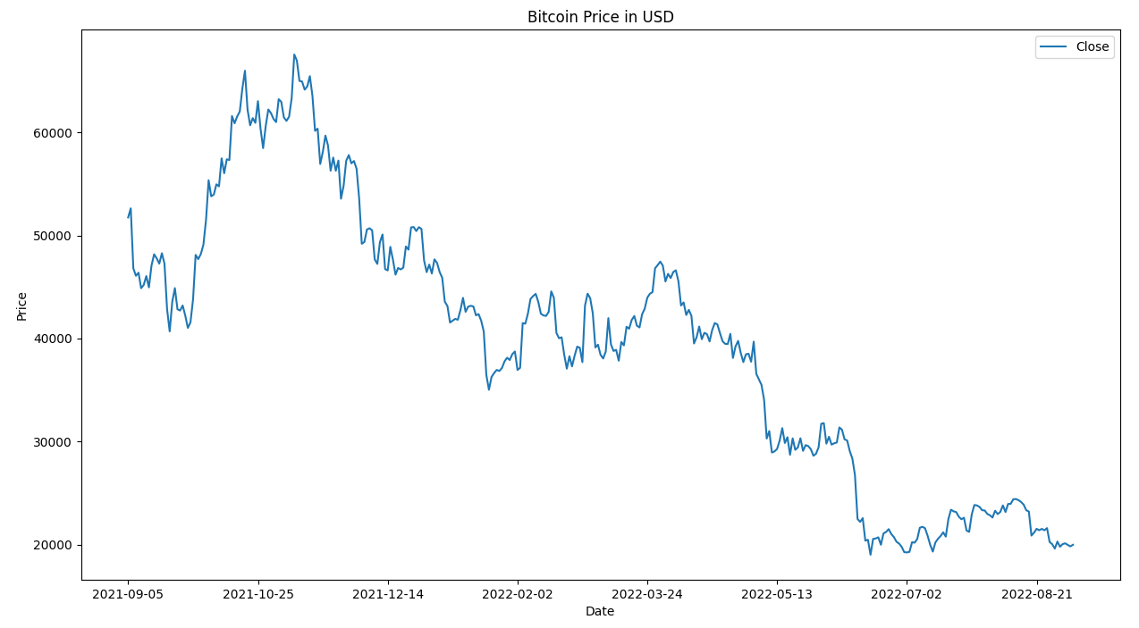

Slide 23
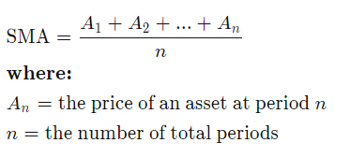
SIMPLE MOVING AVERAGE (SMA)
# create 20 days simple moving average column
df['SMA_20'] = df['Close'].rolling(window = 20, min_periods = 1).mean()
# create 50 days simple moving average column
df['SMA_50'] = df['Close'].rolling(window = 50, min_periods = 1).mean()
df.plot(x = "Date", y = ["Close", "SMA_20", "SMA_50"], kind = "line", figsize = (15, 8), title='Bitcoin Price in USD', xlabel= 'Date', ylabel= 'Price')
plt.show()

Slide 24
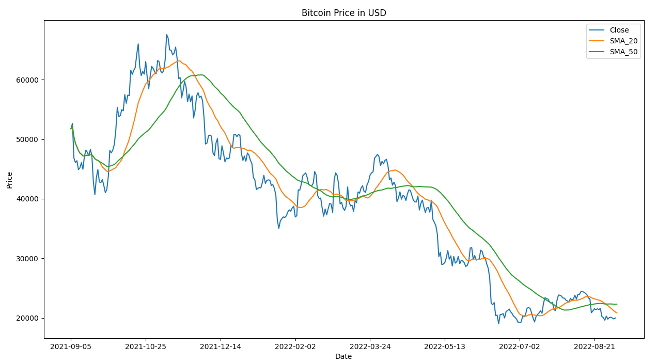

Slide 25
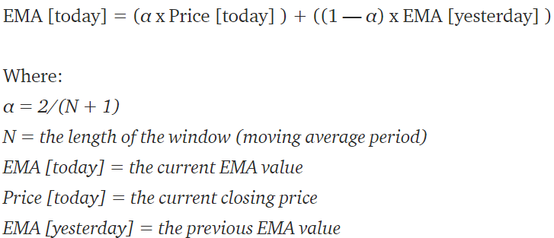
EXPONENTIAL MOVING AVERAGE (EMA)
# create 20 days exponential moving average column
df['EMA_20'] = df['Close'].ewm(span = 20, adjust = False).mean()
# create 50 days exponential moving average column
df['EMA_50'] = df['Close'].ewm(span = 50, adjust = False).mean()
df.plot(x = "Date", y = ["Close", “EMA_20", “EMA_50"], kind = "line", figsize = (15, 8), title='Bitcoin Price in USD', xlabel= 'Date', ylabel= 'Price')
plt.show()

Slide 26
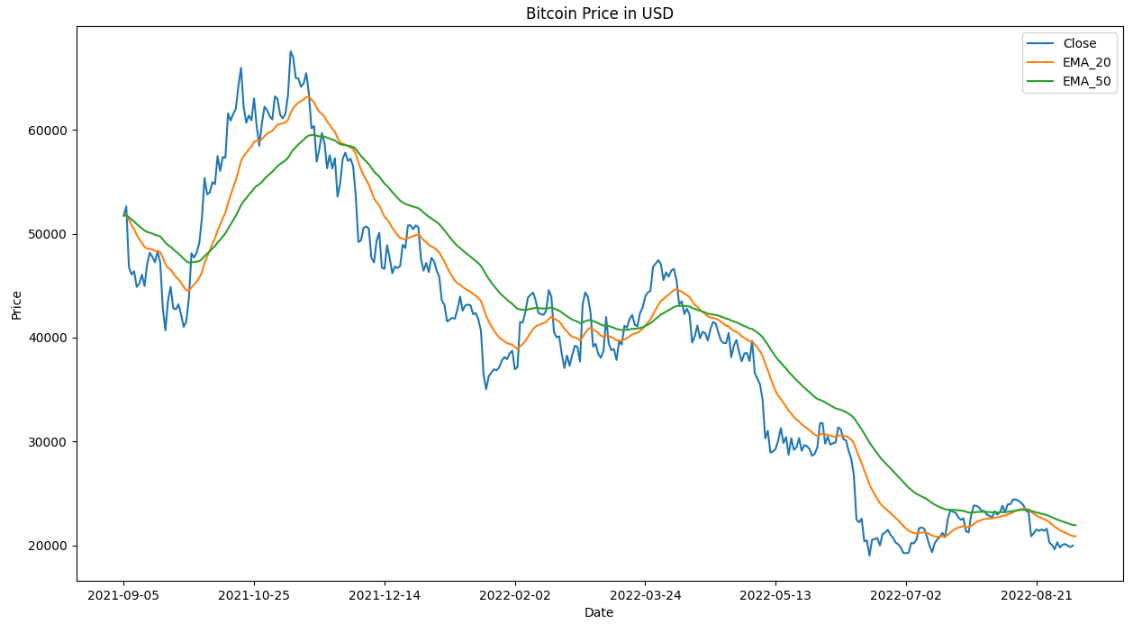

Slide 27
HISTOGRAM TO VISUALISE DAILY RETURN
df = df.set_index('Date’)
df['daily_changes'] = df['Adj Close'].pct_change(periods = 1)
sns.displot(df['daily_changes'].dropna(),
bins=100,
color='purple’,
kde=True,
height = 6,
aspect = 1.5)
plt.suptitle('Daily % return of BITCOIN (USD) price,\n05-09-2021 to 04-09-2022’,
fontsize=12,
color='black’)
plt.grid(True)
plt.show()

Slide 28
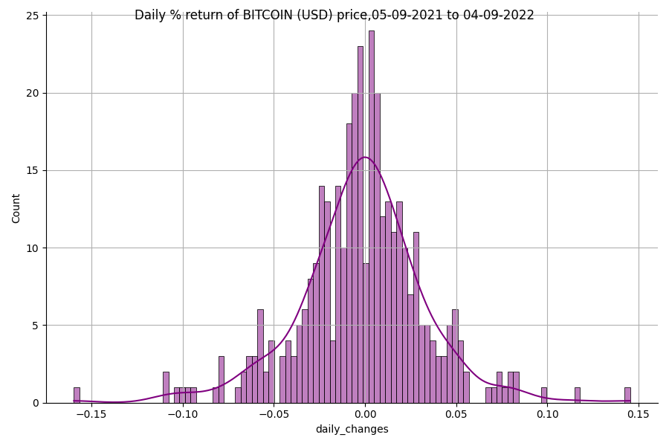
Notes:
It looks approximately normal but if we look to the left of the distribution, we can see the famous fat tails. The fat tails mean that extreme events occur more frequently in reality than what a normal distribution would predict. The skinny middle and the fat tails imply that the normal distribution might not be the best describer of stock returns.

Slide 29
THANK YOU

